Slide 1
GastroChamp
Made by: Roland Tóth, Szebasztián Szabó

Slide 2

General overview
The problem: Less people know how to cook nowadays.
The solution: Communal cookbook available for everyone.

Slide 3
Functionality
Browsing recipes uploaded by other users.
Build-in functions:
Registration and login.
Create recipes.
Ranking system for users.
Levelling up through the ranks.
Liking recipes.
Admin system.

Slide 4
Teamwork
Approach: Work based upon each others strong points
Roland Tóth:
Backend design (Admin, ranking system design)
Database design
Documentation
Basic UI layout
Szebasztián Szabó:
Frontend design
Database coding
Responsivity
Testing

Slide 5
Technologies & Tools used
Software and tools:
Visual Studio Code
Notepad++
Google Drive
PhpMyAdmin
WinSCP
Browsers (Google Chrome, Opera GX)
Languages:
HTML, CSS
JavaScript, PHP
SQL
Frameworks:
jQuery

Slide 6
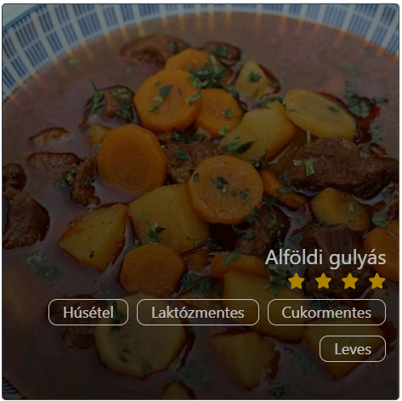
Frontend
UI design approach:
Mobile first approach
Usage of icons
Responsivity
Languages:
HTML
CSS
JavaScript
Frameworks:
jQuery

Slide 7
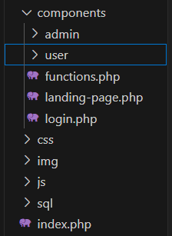
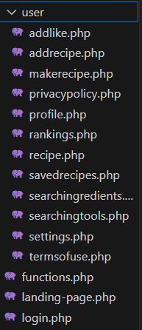
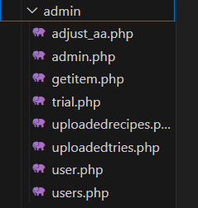
Backend
Languages:
JavaScript
PHP
SQL
Logic & structure
Authentication (Hashing passwords)

Slide 8
Tables
SQL:
MySQL
Data types (String, Integer)
PhpMyAdmin
Stored data:
Public tables
Admin tables

Slide 9
Databases
Public tables:
Users
Foods
Recipe
Categories
Likes
Notifications
Admin tables:
Ingredients
Logs
Reports
Swears
Tools
Tries

Slide 10
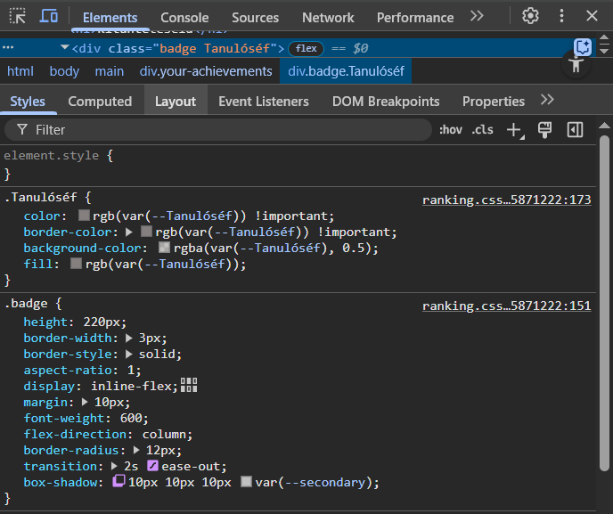
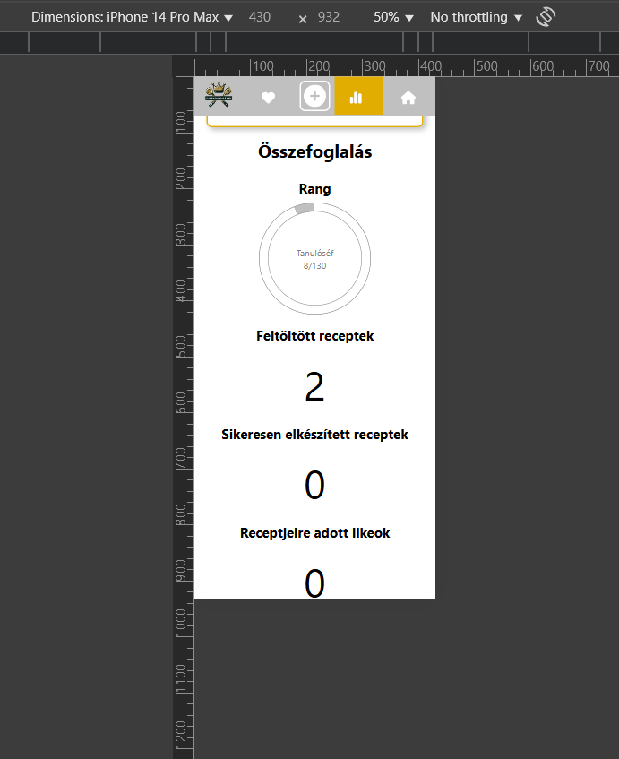
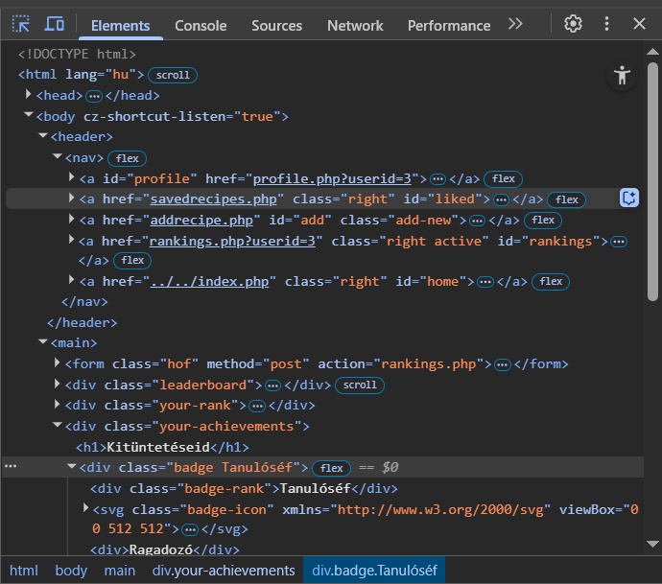
Testing DOM elements
CSS
HTML
Responsive layout

Slide 11
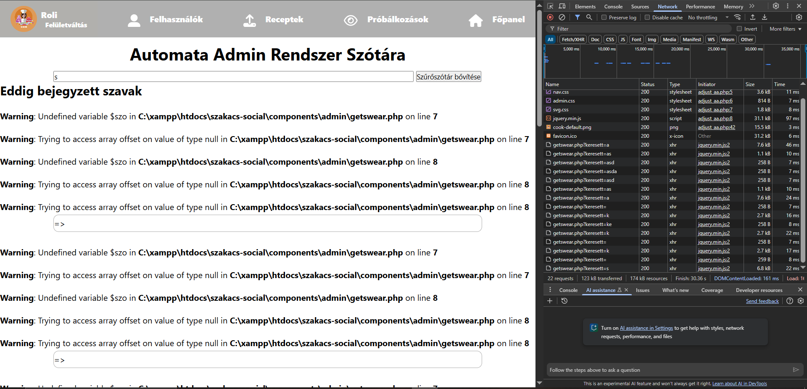
Testing jQuery
PHP and jQuery synergy

Slide 12
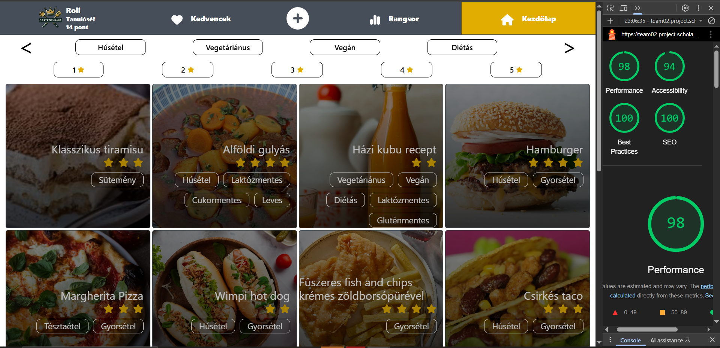
Testing backend performance
Optimalization and SEO

Slide 13
Challenges & future
Emerged issues:
Collaboration
Lack of clean code
What’s next:
Implementing a searchbar for recipes
Data security enchancements
Implementing a 404 website
Built-in AI administrator
Implementing OOP

Slide 14
Thanks for listening!

